Slide 1
AWS Data-Lake
Glue – Athena – S3 - Redshift

Slide 2
TWO – Minutes: Know your Trainer
My name is Kumar Vikas.
Working as a Senior Cloud Architect for one of the BIG4s.
Have 13 years of overall IT experience with expertise in Various cloud technologies, Dev ops, Python, etc.
Worked with AWS & Devops for many years now: Built websites, online gaming apps, data-engineering, migration of various enterprises.
Passionate about teaching and sharing my knowledge with you, which I gathered HARD-WAY !!!!
Notes:
Learning is not a race take your time but set a goal .
To begin with things may look scary but trust me you are at right place with right trainer .I will put effort to keep it simple ,Informative and interactive .
It’s a very hands-on course which keeps you involved and different from any other instructor .
The way I teach is , I will explain everything via diagrams .In this incremental learning process you start at very basic level ,learn new skills , use those skills and reuse them .
You end up with great confidence and industry equivalent experience .

Slide 3
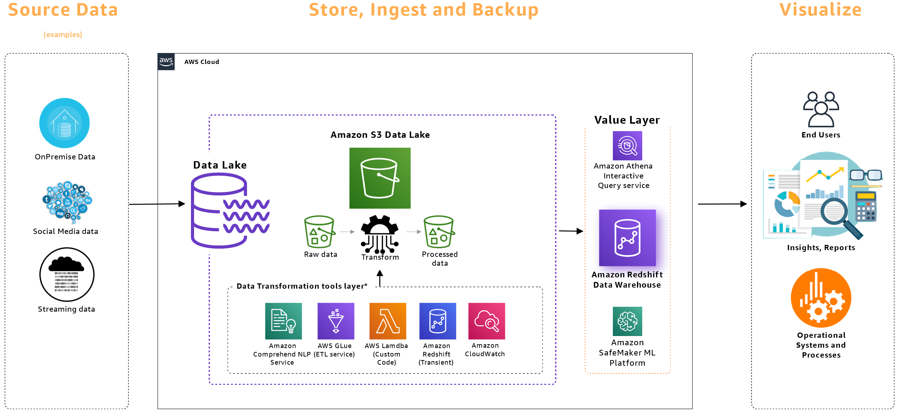

Slide 4
Data lake vs data warehouse: key differentiators
Characteristics | Data Warehouse | Data Lake
Content | Relational from transactional, operational databases, and line of business applications | Non-relational and relational from IoT devices, web sites, mobile apps, social media, and corporate applications
Schema | Designed prior to data warehouse implementation (schema-on-write) | Written on the time of analysis (schema-on-read)
Performance/Price | Fastest query results in using a higher cost storage | Query results getting faster using low-cost storage
Quality | Curated data that serves as the primary source of information | Any data - structured or unstructured
Users | Business analysts | Data scientists, big data engineers, and business analysts (when using structured data)
Analytics | Batch reporting, BI and visualizations | Machine Learning, predictive analytics, data discovery, and p

Slide 5
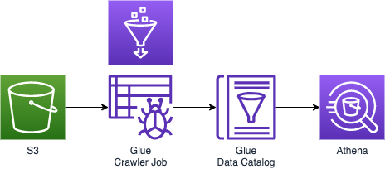
Notes:
Glue:
1. Discover - Automatically discover & categorize your data so that it can be searchable and queryable across data sources.
2. Develop – Generate code to clean, enrich & reliably move customizable data among sources,
3. Deploy – Run your jobs on a serverless , Fully managed & scale-out environment .Nothing to provision and manage.

Slide 6
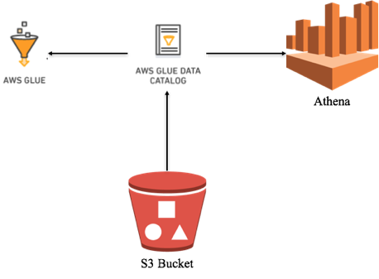

Slide 7
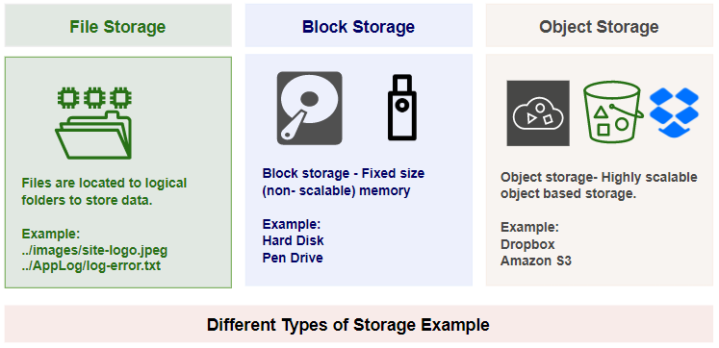

Slide 8
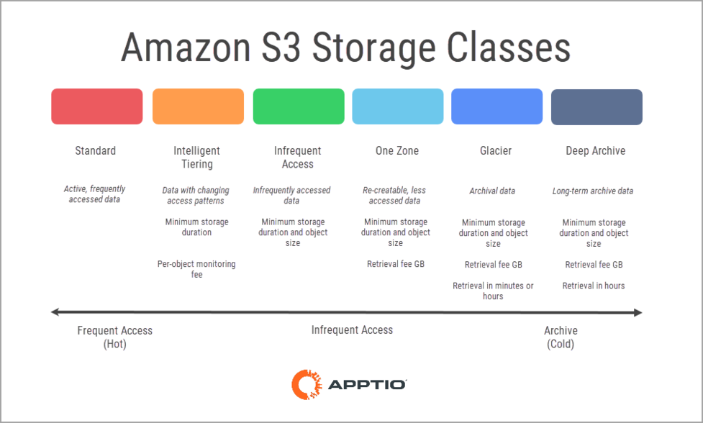

Slide 9
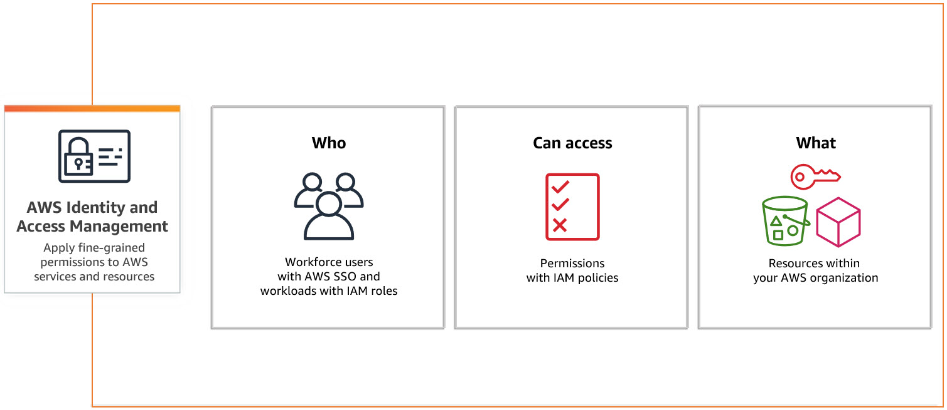

Slide 10
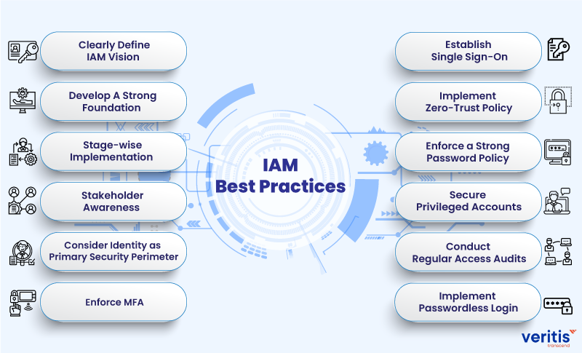

Slide 11
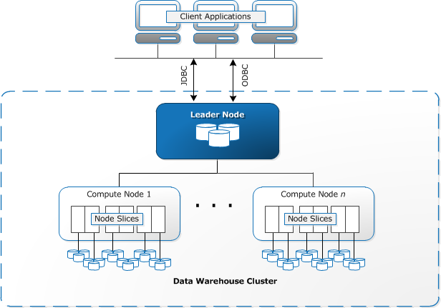

Slide 12
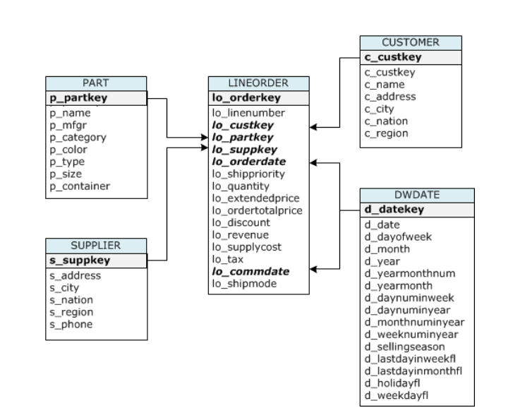

Slide 13
Applications of Spark
Big Data With PySpark and AWS
Streaming Data
Machine Learning
Batch Data
ETL Pipelines
Full load and Replication on going
Notes:
Speed
Distributed
Advanced Analytics
Real Time
Powerful Caching
Fault Tolerant
Deployment

Slide 14
Spark Architecture
Workers
Driver Node
Spark Context
Cluster Manager
Workers
Notes:
RDD is the spark’s core abstraction which stands for Resilient Distributed Dataset
RDD is the immutable distributed collection of objects
Internally spark distributes the data in RDD, to different nodes across the cluster to achieve parallelization.

Slide 15
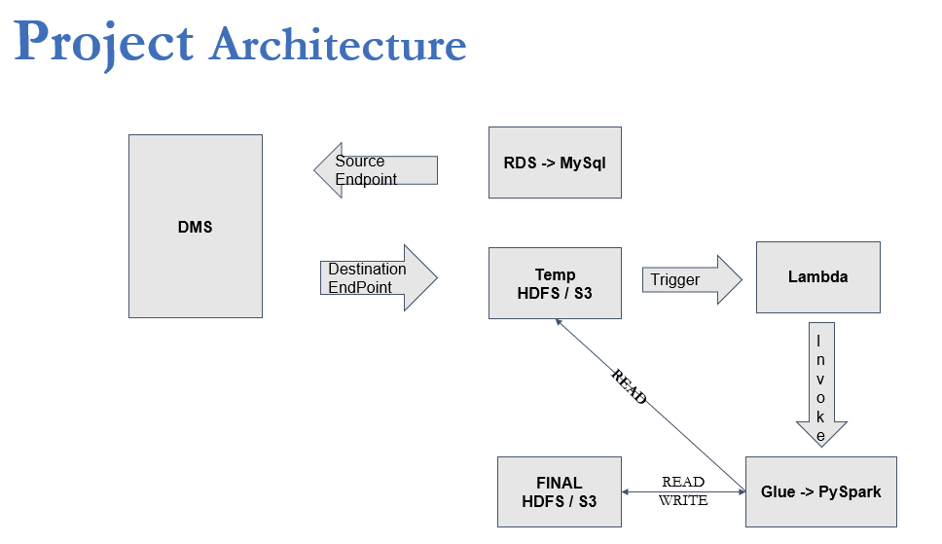
CDC - Change Data Capture / Replication On Going
Notes:
Create a My-SQL DB:
Public access – yes
Parameter group details -- Parameter group family (mysql 8.0)
Edit binlog_format = ROW
Create DB

Slide 16
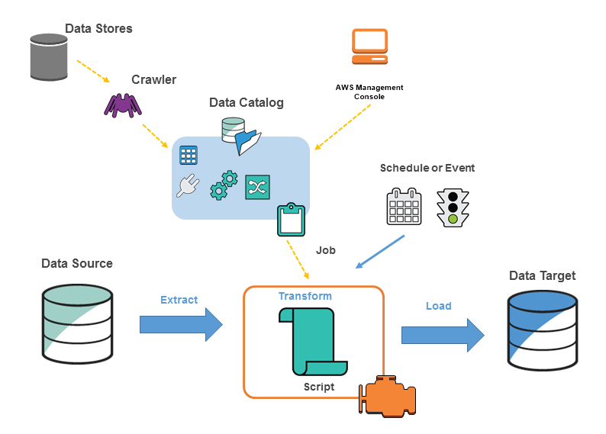
Notes:
ETL – 80%
Redshift - DW

Slide 17
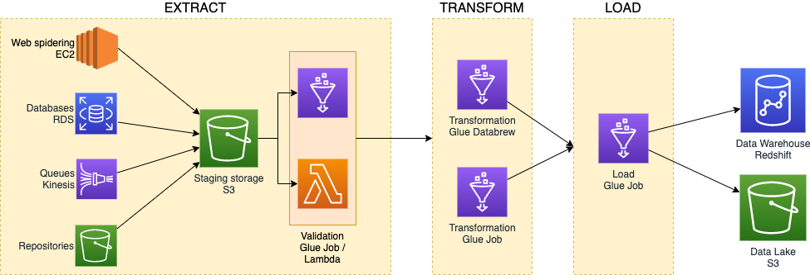
Notes:
https://www.proud2becloud.com/etl-orchestration-on-aws-with-aws-step-functions/

Slide 19
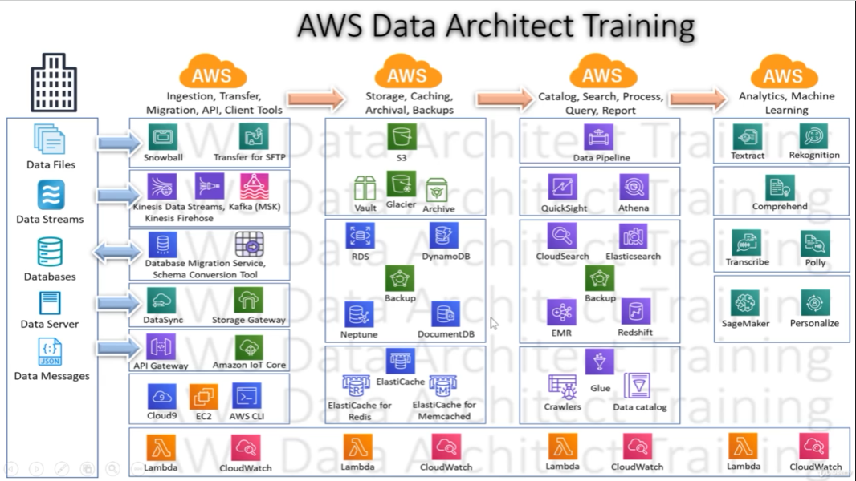

Slide 20
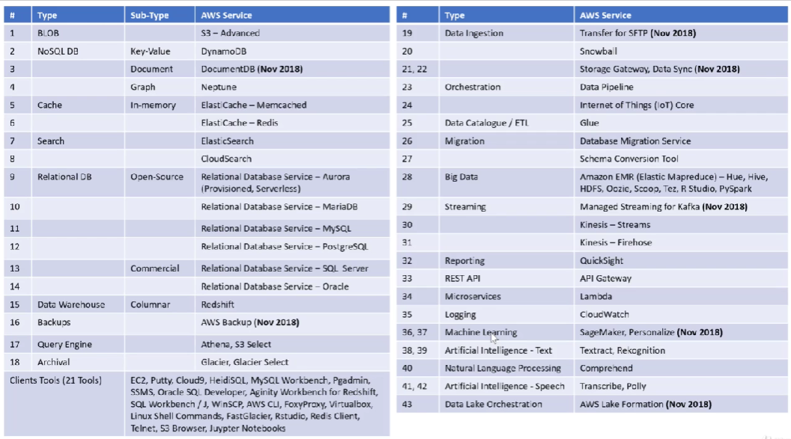

Slide 21
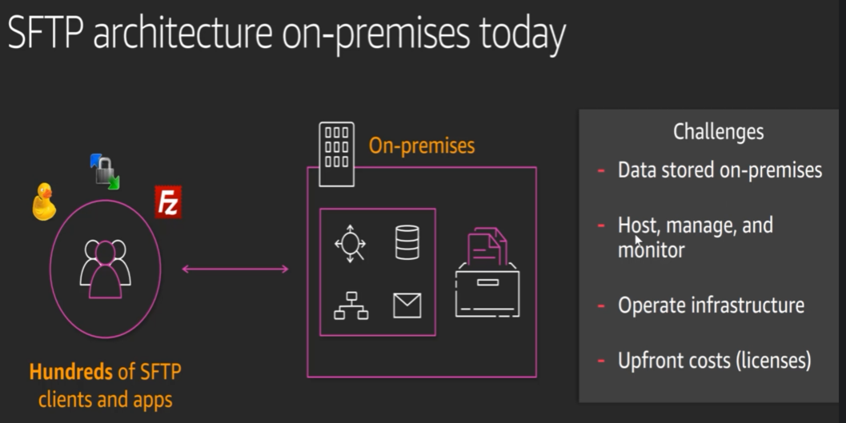

Slide 22
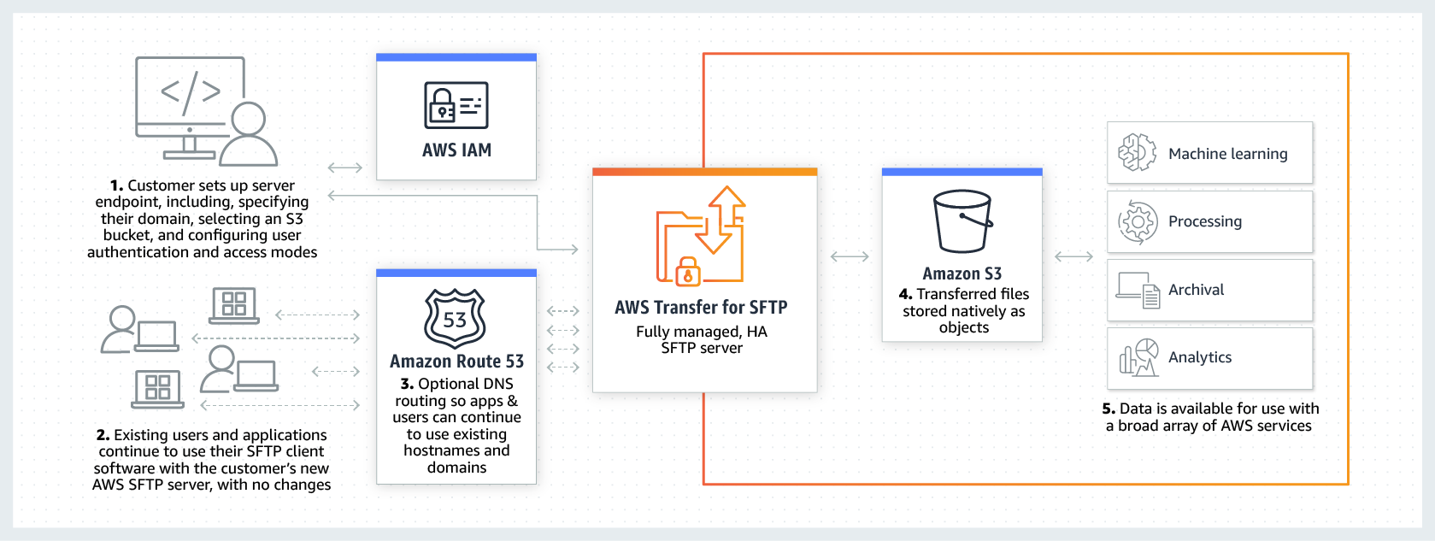

Slide 23
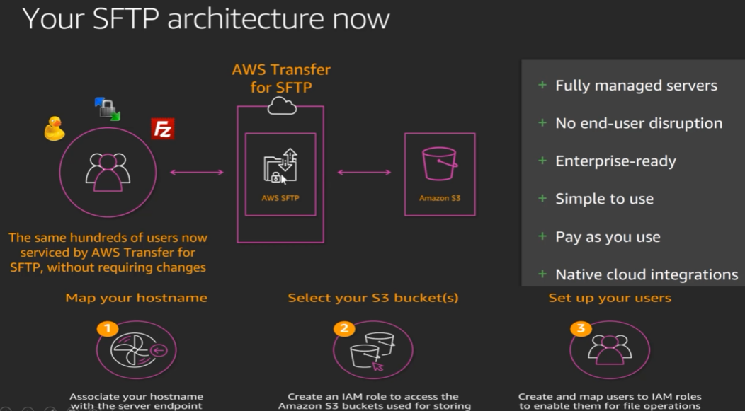

Slide 24
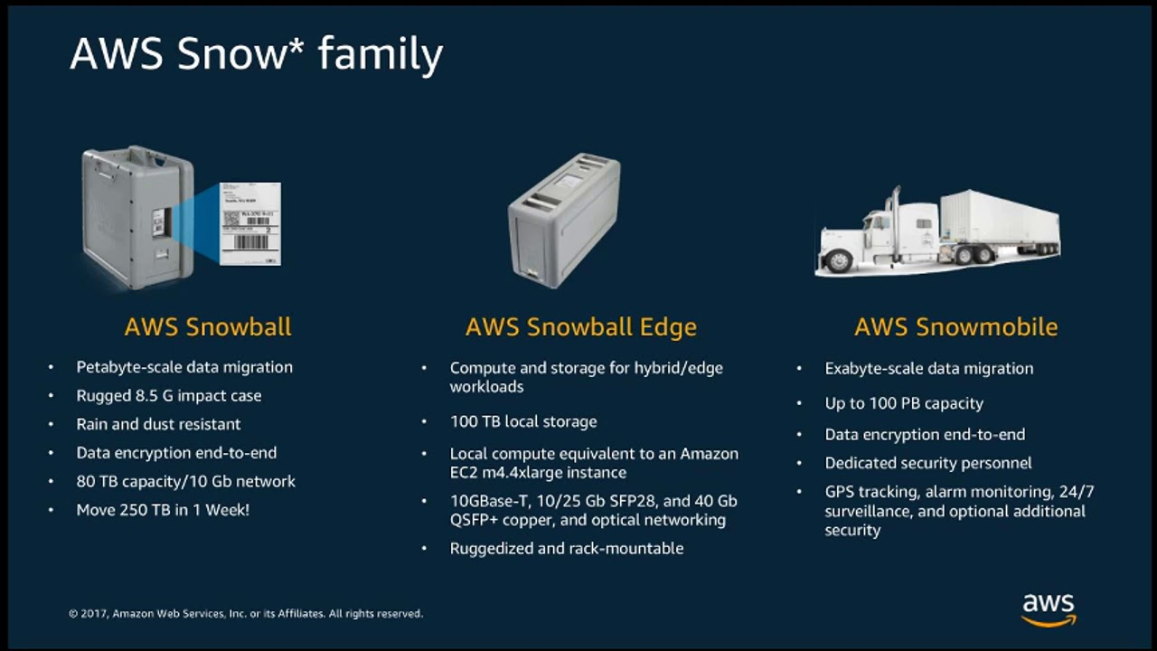

Slide 25
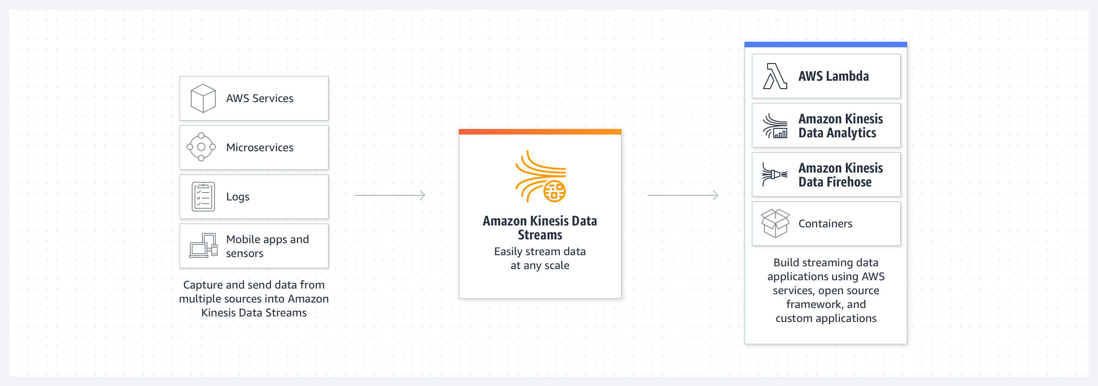

Slide 26
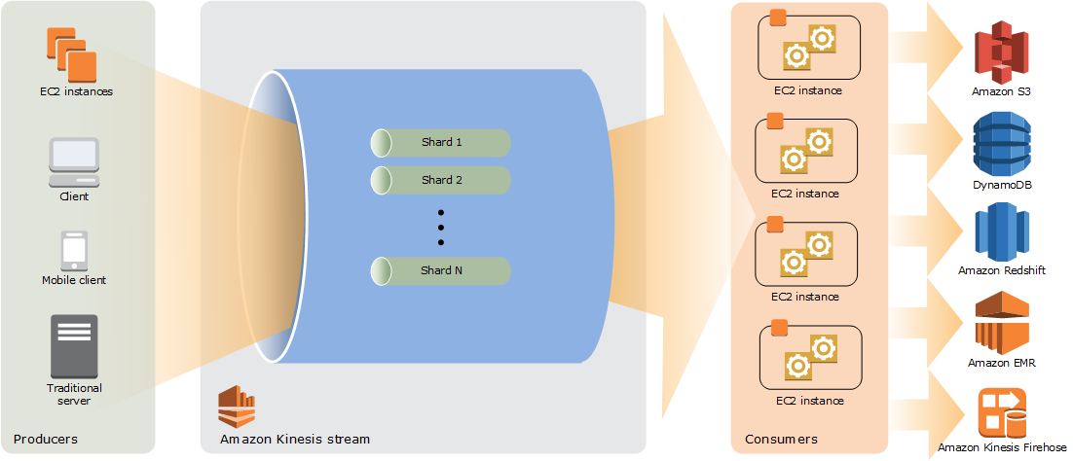

Slide 27
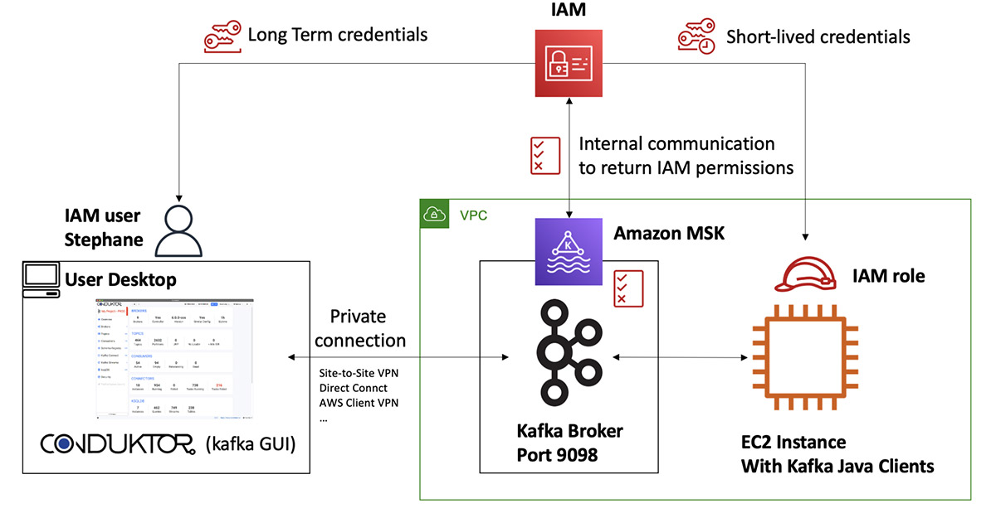

Slide 28
